Slide 1

Discovering
Your
Sense of It

Slide 2

Each of us has a special path we must walk to reach our special purpose in life. Sometimes this path is easy to find. Sometimes we must search and struggle to find the path God created for us to follow. Life has so many stages for us to get through. First, we are babies, then children, then teens then young adults, then middle-agers, and finally we are senior citizens. What is right for us at one stage of our life may be wrong for us at another stage of our life. We must be flexible. We must continue to grow and discover new paths that are especially meant for us. Following this page are a few questions to ask yourself and space to write your reflections. I have also put a few quotations that have meant a lot to me in my journey through life. Perhaps some of these will connect with you and cause you to reflect on what and who you are meant to be.

Slide 3

The Sense of It by Linda DeGree
What? You are. Going to drop out of high school? Are you daft?
There is a war on. You are strong and athletic. You will be
sure to be drafted.
I will not fight in this war, Margie. I will not put myself in the
Position of killing another person because my country is at
War with their country.
What will you do?
I am not sure what steps I need to take. I will leave home.
I don’t want to put my family in danger. I will find a way
To make my life meaningful.
Join siblings Margie and James as they search for their own “sense of it”
in their personal lives as they find their individual ways to Live for Peace.

Slide 5

Questions to ask yourself:
1. What are your talents?
2. What do you enjoy doing?
3. What education will you need.
4. What am I doing to develop my talents?
5. What are my goals?
5. What steps do I need to take to accomplish my goals?
6. What are your costs?
7. Who can I reach out to support me in accomplishing my goals?
8. What is your time frame?
9. What are your costs?
10. How will you procede?

Slide 6

If you see someone without a smile, give them one of yours.
Tell about a time you found a way to brighten up someone’s day.

Slide 7

Those who cannot see the laughter in life, lack insight.
Tell about a time that embarrassed you at the time, but now you look back on it with laughter.
This Photo by Unknown Author is licensed under CC BY-NC

Slide 8

If you love someone very much, you have to let them go sometimes. If they come back to you, your friendship will be all the more cherished.
(Tell about a time you rekindled a friendship.)
This Photo by Unknown Author is licensed under CC BY-SA-NC

Slide 9

If you think you can or you think you can’t you are absolutely right.
(Tell about a time you gave up before you tried, or tell about a time you had the confidence to succeed.)
This Photo by Unknown Author is licensed under CC BY-ND

Slide 10
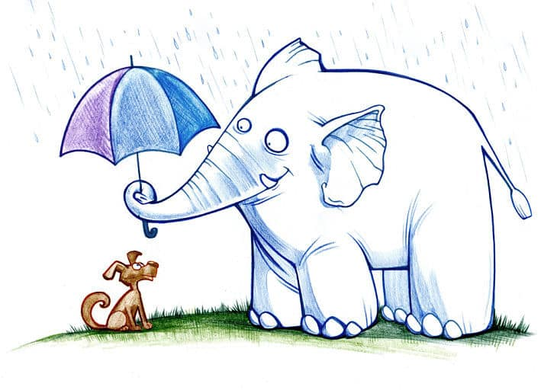
Throw Kindness around like Confetti
(Tell about a time that the kindness around you encouraged you when you were discouraged.)
This Photo by Unknown Author is licensed under CC BY-SA

Slide 11

Leave a little sparkle wherever you go.
(Tell about a time you wowed someone.)
This Photo by Unknown Author is licensed under CC BY

Slide 12

(Tell about a time you made a difference in the world.
This Photo by Unknown Author is licensed under CC BY-SA-NC

Slide 13

(Tell about a time you made a mistake, and it helped y. Mistake and it. It helped you learn even more.)
This Photo by Unknown Author is licensed under CC BY

Slide 14

We are given many gifts in life,
Finding you,
Loving you,
Being loved by you
Is my important,
Vital,
Gift.
This Photo by Unknown Author is licensed under CC BY

Slide 15


Write a story about love!

Slide 16
Keep going!

Slide 17

Your imagined life goals come true.
Tell about your journey.
This Photo by Unknown Author is licensed under CC BY-SA

Slide 18

This Photo by Unknown Author is licensed under CC BY-NC-ND

